Slide 1

RESEARCH TOOLS AND SOFTWARE

Slide 2
PLAGIARISM
to use the words or ideas of another person as if they were your own words or ideas
to steal and pass off (the ideas or words of another) as one's own : use (another's production) without crediting the source
to commit literary theft : present as new and original an idea or product derived from an existing source

Slide 3
WHAT DOES PLAGIARISM LOOK LIKE?
Copying someone’s work
Citing a source improperly
Failure to cite a source
Creation of false sources
Turning in another person’s work as your own

Slide 4
SOME OF THE THINGS ABOUT PLAGIARISM
Alive or dead, it does not matter. If it is not your own idea, you must cite your source!!
If you translate or paraphrase something, you must still give a citation
You may have been told that if you put something into your own words, you need not cite. This is incorrect. The material is still someone else’s idea and requires acknowledgement.

Slide 5
HOW DO JOURNALS DETECT PLAGIARISM
Large passages quoted verbatim from the source document with very little modification.
Reviewers get suspicious if:
the author’s writing style varies considerably between passages in the submitted manuscript
the level of English used is very different in different parts of the manuscript
the reviewer is familiar with the work that has been plagiarized

Slide 6
HOW TO AVOID PLAGIARISM
SUMMARIZE
You must reference the original source
summary should be shorter than the text you are summarizing
You must use your own words, usually with a very limited use of quotations
PARAPHRASE
You must reference the original source
The text you produce may be shorter or longer than the original text
You must use your own words
QUOTE
You must use the original author’s exact words and you must put quotation marks around them
You can introduce quotes with phrases like According to Bob Jones, “ABC” or Bob Jones stated, “ABC”

Slide 7
ONLINE PLAGIARISM CHECKER
https://www.plagaware.com/
https://smallseotools.com/plagiarism-checker/
https://www.bibme.org/grammar-and-plagiarism/
https://edubirdie.com/plagiarism-checker
https://www.quetext.com/
https://www.prepostseo.com/plagiarism-checker
https://www.grammarly.com/plagiarism-checker
http://plagiarisma.net/
https://www.plagramme.com
https://plagiarismdetector.net/
http://ithenticate.com/
http://www.plagiarizechecker.com/
https://copyleaks.com/
https://searchenginereports.net/plagiarism-checker/
https://www.duplichecker.com/
https://plagiarismsearch.com/
https://unicheck.com/
http://en.writecheck.com/
http://plagiarismdetection.org/
http://scholarplagiarism.com/
https://essaywriters.us/plagiarism-checker/
https://www.plagiarismcheckerfree.com
http://www.plagiarismsoftware.in/
https://plagly.com

Slide 8
Plagiarism tools | Pros | Cons
DUPLICHECKER | Free Of Charge Ease Of Use 50 Plagiarism Scans Per Day For Registered Users | 1 Search Per Day For Unregistered Users
COPYLEAKS | Multiple File Formats And Languages Copyleaks allows you to use the API tool to search for plagiarized | You Can Use It Only After You Sign Up Free Page Restriction first 10 pages are for free.
PAPERRATER | 3 Tools In 1: Proofreader & Grammar Check, Vocabulary Builder, Plagiarism Checker | No Ability To Save Report
QUETEXT | Entirely free. Unlimited Usage | No File Uploading
PLAGIARISMA | 190+ Languages Supported Plagiarism Check By URL, Online Or File Upload | Limited Plagiarism Checks Per Day

Slide 9
REFERENCE
A Works Cited is a list of sources that goes at the end of you paper or presentation that tells the reader all the sources you have used.
Formatting sources in a Works Cited is different from formatting an in text citation.
A referencing style is a specific format for presenting intext references (footnotes or endnotes), and bibliography.

Slide 10
WHY TO REFERENCE ???
Proves that substantial research has been done to support our analysis .
Enables others to follow up on our work .
Gives credit to other people's work .
Avoids charges of plagiarism.
Required to support all significant statements.
Used to indicate the origin of material & source for research & further reading.

Slide 11
DIFFERENT STYLES OF WRITING REFERENCES
Harvard style of referencing.
American Psychological Association style (APA) .
Vancouver style.
MLA citation style (modern language association ).
The Chicago manual of style .
Royal society of chemistry style.

Slide 12
HARVARD STYLE OF REFERENCING…
Author’s name followed by its initials.
Year of publication.
Article title with single quotation mark followed by full stop.
Name of Journal in italic form.
Volume followed by a comma
Issue no. in bracket.
Page no.
Example: Padda, J. (2003) ‘creative writing in coventry'. Journal of writing studies 3 (2), 44-59.
Lennernas, H. (1995) ‘Experimental estimation of the effective unstirred water layer thickness in the human jejunum & its importance in oral drug absorption’. Eur. J. pharm sci (3), 247-253.

Slide 13
MLA CITATION STYLE (MODERN LANGUAGE ASSOCIATION )
Authors name.
Title of article.
Name of journal.
Volume number followed by decimal & issue no.
Year of publication.
Page numbers.
Medium of publication.
Example Matarrita-Cascante, David. "Beyond Growth: Reaching Tourism-Led Development." Annals of Tourism Research 37.4 (2010): 1141-63. Print

Slide 14
CHICAGO
Name of author.
Article title in double quotation mark.
Title of journal in italic.
Volume.
Year of publication.
Page no.
Example Joshua I. Weinstein, “The Market in Plato’s ” Classical Philology, 104 (2009): 440.

Slide 15
AMERICAN PSYCHOLOGICAL ASSOCIATION STYLE
Author’s name followed by its initials.
Year of publication.
Article title followed by full stop.
Name of Journal in italic form
Volume followed by a comma
Page no.
Example Alibali, M. W., Phillips, K. M., & Fischer, A. D. (2009). Learning new problem-solving strategies leads to changes in problem representation. Cognitive Development, 24, 89-101.

Slide 16
REFERECING FROM VARIOUS SOURCES
Book Author : Last Name, Author First Name. Title of Book. City of Publication: Publisher, Year of Publication. Medium of Publication.
Essay or Chapter in Book Author: Last Name, Author First name. “Title of Essay/Chapter.” Title of Book. Ed. Editor's Name(s). City of Publication: Publisher, Year. Page range of entry. Medium of Publication.
Article: Author Last Name, Author First Name. “Title of Article.” Title of Periodical Day Month Year: pages. Medium of publication.

Slide 17
REFERECING FROM VARIOUS SOURCES
Entire Website Author/Creator’s Name (if available). Name of Website. Name of institution/organization affiliated with the site (sponsor or publisher), date of resource creation (if available). Medium of publication. Date of access.
Page on a Website Author Name (if available). “Name of Article.” Name of Website. Name of institution/organization affiliated with the site (sponsor or publisher), date of resource creation (if available). Medium of publication. Date of access.

Slide 18
Reference list – a list of sources we have cited in our text arranged in the order they appeared within the text. It is usually put at the end of our work but it can also appear as a footnote (at the bottom of the page), or endnote (at the end of each chapter) which serves a similar purpose.
Bibliography – a separate list of sources we have consulted but not specifically cited in our work including background reading. It is arranged alphabetically by the author's surname.

Slide 19
ONLINE REFERENCING SITES
ZOTERO | Free referencing tool that allows you to collect, cite, organize and share research sources. . Zotero supports all the major citation formats. You can include the references in your text by simply dragging and dropping citation files from the Zotero library into the document.
MENDELEY | Free referencing manager and social network that helps you organize research, collaborate online and discover new research. Mendeley Writing Addins are available for MS Word which enables you to insert references into your article and generate a bibliography list.
REFWORKS | Reference management software quite similar to EndNote. The references can be included in the text using RefWorks’s Write-n-Cite Microsoft Word Addin. This plugin allows users to insert references in the text and generate a bibliography in a wide variety of formats.
DOCEAR | Docear helps you to find relevant literature and remember all the things you read in the literature.

Slide 20
PROOF READING
The word implies is the process of reading the proof to check for errors; proof is the crude manuscript that is sent to a publisher.
Proofreading is the act of searching for errors before you hand in the your research paper. Errors can be both grammatical and typographical in nature, but they can also include identifying problems with the narrative flow of your paper [i.e., the logical sequence of thoughts and ideas], problems with concise writing [i.e., wordiness], and finding any word processing errors [e.g., different font types, indented paragraphs, line spacing, uneven margins, etc.].

Slide 21
IMPORTANCE OF PROOFREADING IN RESEARCH PAPERS
If you do not proofread and do not make sure that you have eliminated every error possible then your research work will not look at its best.
While the originality and organization of your research work are the most important facets of any research paper you write, the way you present your ideas in your paper says a lot about the kind of care that has gone into your writing.
Your research paper should be not only neat but also readable in terms of how well you have formatted and placed your content.
Good research papers (not only well written but also well edited and formatted) tend to reflect an individual’s thinking through their writing to the readers of the paper.

Slide 22
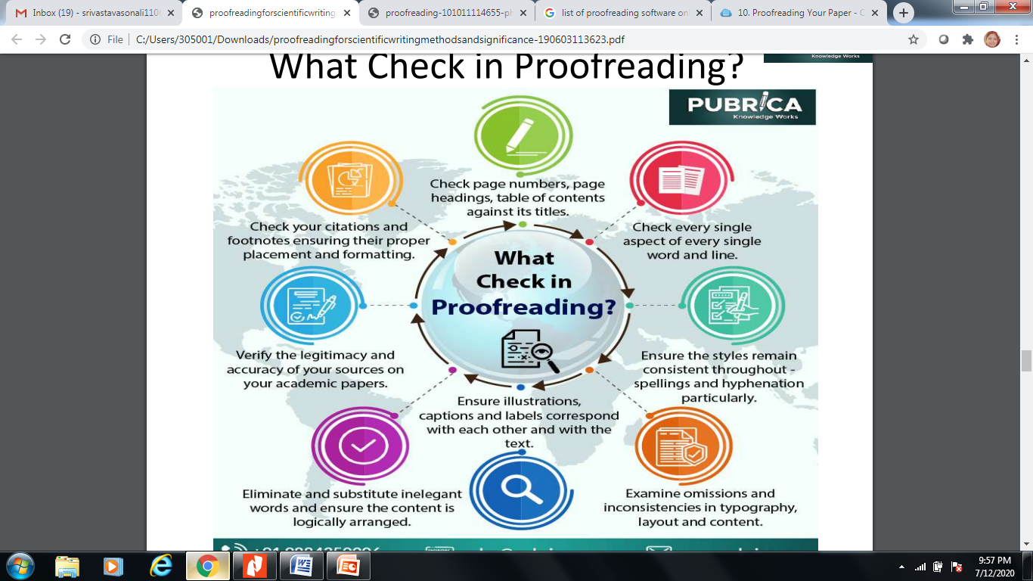

Slide 23
PROOFREADING TIPS
Double check for errors you typically make
Read slowly, read one word at a time to determine if it makes sense
Look for formatting and alignment errors
Read what is actually on the page and not what you think
Errors easily overlooked in first few lines and last few lines of document
Check all numbers and spellings of questionable words with original copy
proofread more than once (if possible in pairs--one reads original and the other the keyed copy)

Slide 24
ERRORS MISSED BY SPELL/GRAMMAR CHECK
Names and addresses not in computer’s dictionary
homonyms that are not misspelled but misused (i.e., they’re/their/there)
Numbers only verified by checking original copy
Repeated words and omitted words
Formatting errors punctuation or capitalization errors
Such as incorrect paragraph indentions or spacing between lines and words

Slide 25
Note that references to prior research mentioned anywhere in your paper should always be stated in the past tense.
Abstract--past tense [summary description of what I did]
Introduction--present tense [I am describing the study to you now]
Literature Review--past tense [the studies I reviewed have already been written]
Methodology--past tense [the way I gathered and synthesized data has already happened]
Results--past tense [the findings of my study have already been discovered]
Discussion--present tense [I am talking to you now about how I interpreted the findings]
Conclusion--present tense [I am summarizing the study for you now]

Slide 26
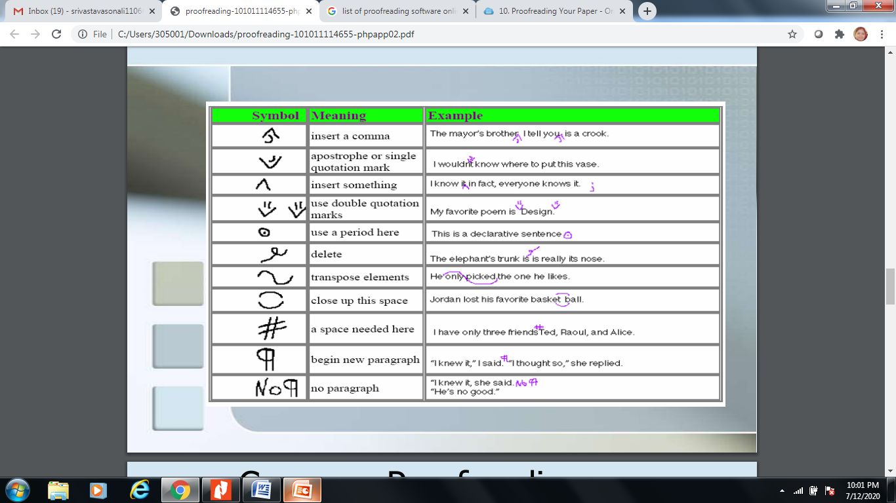
COMMON PROOFREADING SYMBOLS

Slide 27
ONLINE PROOFREADING TOOLS
Paperrater
Typely
Grammarly
Proofreading Tool
Wordy
Slick Write
Ginger Software
Proofread Bot
Linguix
Polishmywriting

Slide 28
ONLINE PROOFREADING TOOLS
GRAMMARLY | This is a multi-purpose tool for writers and bloggers. You can paste your content after writing, and this will check for any spelling or grammatical mistakes. Check out Grammarly review.
POLISHMYWRITING | It points out the error in three different colors. A red one for the spelling error, Blue one for style suggestions and Green for grammatical errors.
GINGER | It works almost the same like Polishmywriting, but it also takes care of your “article error” like using the, a, an. Polishmywriting doesn’t give you suggestions for a, an, the, have, has, etc.
SLICK WRITE | If you are not in a hurry and want to analysis your writing in detail, then you must check out Slick Write. Slick Write not only points out your errors but also gives you an analysis of your writing which lists phrases, filler words, uncommon words, adverbs, passive words, prepositions and lots more.

Slide 29
PARAPHRASING
A rewriting of text in your own words
Used to clarify meaning
Used to shorten a longer statement but keeps the main ideas
A way to enhance vocabulary

Slide 30
STEPS TO PARAPHRASE
Read the passage carefully
Decide the main ideas of the passage
Highlight important words or phrases
Put the main points in your own words

Slide 31
GUIDELINES FOR PARAPHRASING
1. Change the structure or order of the sentence and/or paragraph.
Students seem to be under serious stress because they have so much homework.
Since they have so much homework, students seem to be under serious stress.
2. Find appropriate synonyms.
Students seem to face serious pressure due to countless homework.
Learners appear to be under severe stress because they have so many assignments.

Slide 32
GUIDELINES FOR PARAPHRASING
3. Change word forms.
Students seem to be under serious stress because they have so much homework.
Students feel seriously stressed because they have so much homework.
4. Now put all the strategies together:
researchers seem to be under serious stress because they have so much homework.
Because so many assignments are being given to students, they appear to be seriously stressed.

Slide 33
ONLINE PARAPHRASING TOOLS
Expressiongenie.com: The tool is one of the most reliable online when it comes to converting sentences into their new versions, preventing from committing plagiarism.
Text Compactor: It is an effective yet easy to use paraphrasing tool that you can depend on if you want instant and accurate results. No matter you need a new blog or essay rewritten to make it unique, this is the reliable tool for you.
You Paraphrase: The website is one of the best when it comes to paraphrasing because it can be used free, online and without downloading software.

