Slide 1
How to catch Cloned/Predatory Journals
Dr.Mansi Tiwari

Slide 2
Cloned journals
Clone journal web pages are a counterfeit mirror of an authentic journal that exploit the title and ISSN of legitimate journals. In contrast to predatory journals, clone journals are more likely to accept papers from authors, since they have developed as the mirror image of reputable journals, including their domain name. Some of these counterfeit journals actively chase authors through a modified e-mail message that announces a fake call for papers in a current issue of the journal. Authors may be duped by these solicitations into paying an open-access publication fee, trusting that their work is about to be published in a reputable journal.

Slide 3
Predatory Journals
Predatory publishing is called write-only publishing or deceptive publishing. It is an exploitive publishing business model that involves charging publication fees to authors without checking articles for quality and legitimacy and without providing the other editorial and publishing services that legitimate academic journals provide, whether open access or not.
They are regarded as predatory because scholars are tricked into publishing with them, although some authors may be aware that the journal is poor quality or even fraudulent. New scholars from developing countries are said to be especially at risk of being misled by predatory publishers. According to one study, 60% of articles published in predatory journals receive no citations over the five-year period following publication.

Slide 4
Wrong Impact Factors
Check this website for wrong/misleading https://predatoryjournals.com/metrics/
Only two impact Factors are to be considered
Cite Score by Elsevier (SCOPUS)
Journal Citation Report by Clarivate Analysis (Web of Science)

Slide 5
Important Links
https://ugccare.unipune.ac.in/Apps1/User/Web/CloneJournals (Check this link carefully)
You can also email to:
titlesuggestion@scopus.com and ask about any SCOPUS indexed journal’s status

Slide 6
Few CRUCIAL POINTS CHECKLISTS
Most Fake/Predatory/Cloned journals will not have any submission deadlines.
2) They will always charge money and will give you early publications.
3) Most of them will be having multiple journals doing the same job.
4) They also use the cloned websites with same logo and ISSN number
5) They have fake stamps of SCOPUS or WEB OF SCIENCE Indexing.
6) Google indexing is very easy and there is no science involved in it and it us not useful anywhere in academics, but it gives you more citations.

Slide 7
few Crucial points continued…
7) Always see the UGC CARE List and SCOPUS DATA before submitting to any journal.
8) Always check the WEB OF SCIENCE indexing.
9) Always check the making of the websites.
10) There will be no contact details of the Chief Editor and Editor or else they will fake people.
11) The journal must give you a Digital Object Identifier (DOI) number.
12) Most renowned journals are now integrating the ORCID ID with research publications.
13) Most of the Fake/Predatory/Cloned journals will use Gmail accounts not the official ones used for the journals.
14) Check, check and always recheck the details given on the website

Slide 8
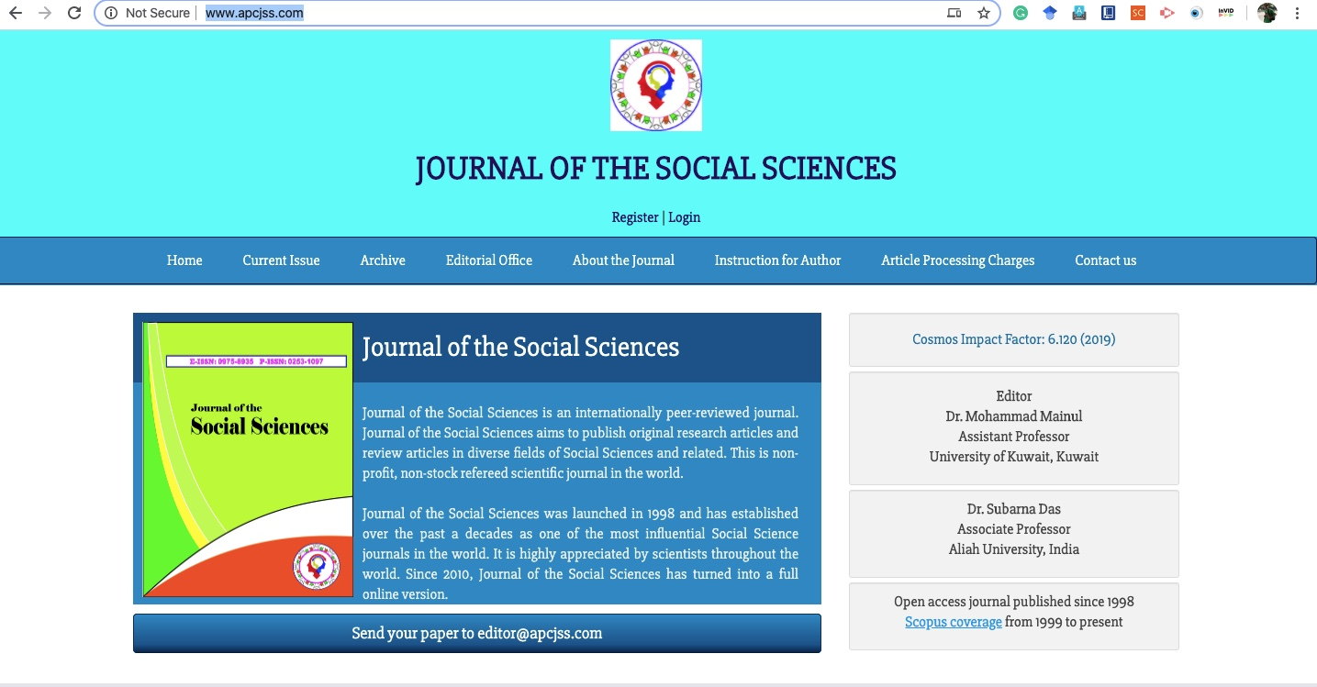
There will be no contact details of the Chief Editor and Editor or else they will fake people

Slide 9
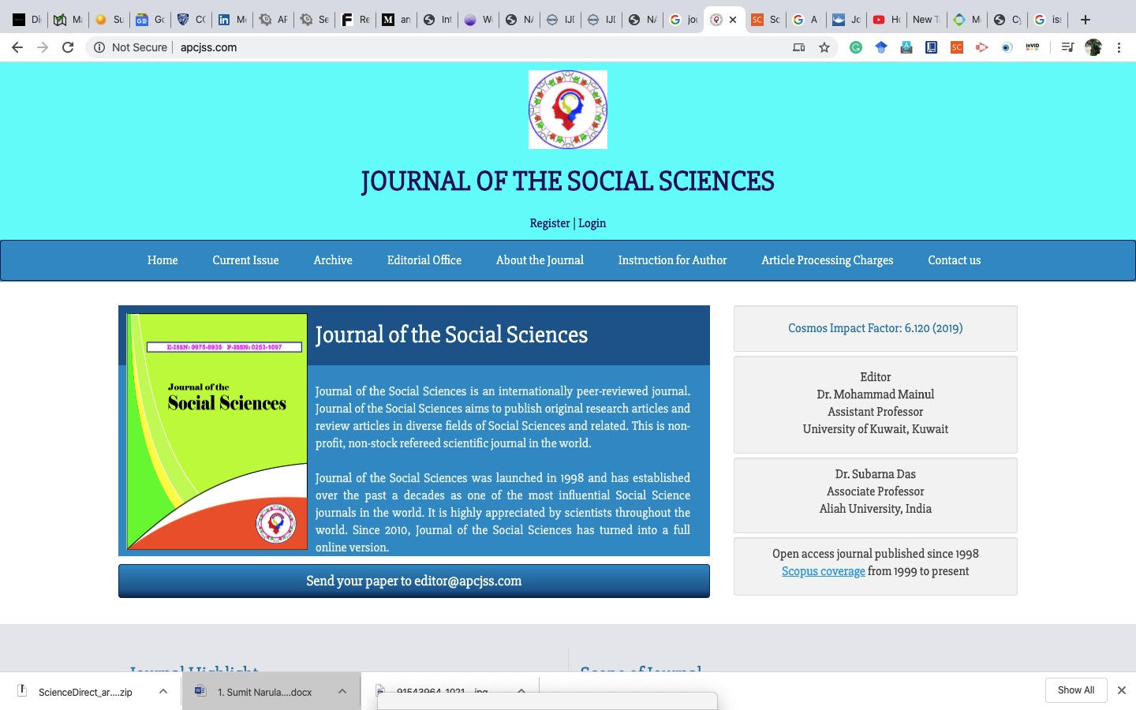
Journal without contact details

Slide 10
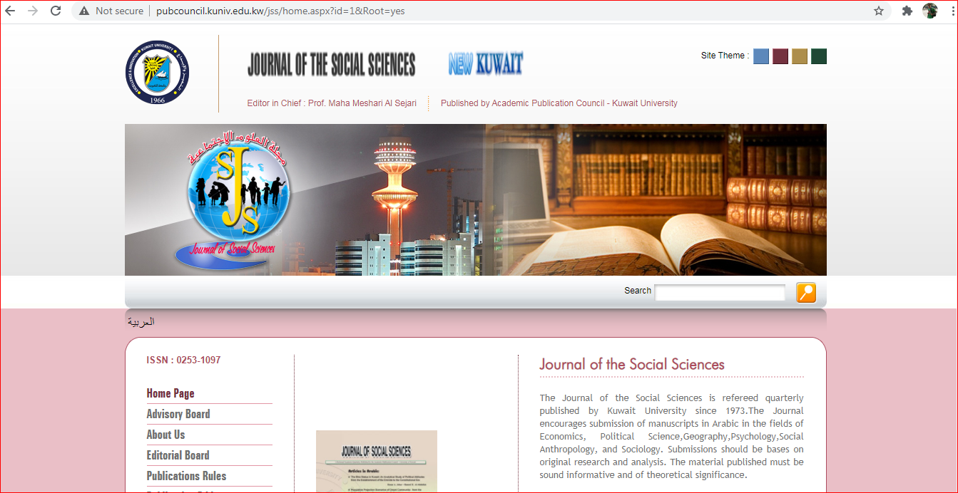
Original Website is in Kuwait

Slide 11
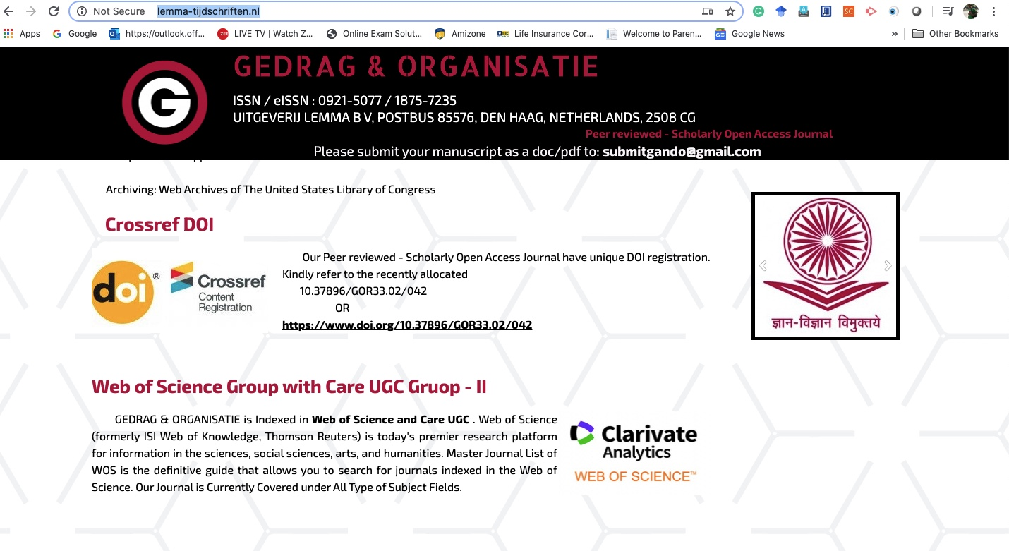
Most of the Fake/Predatory/Cloned journals will use Gmail accounts not the official ones used for the journals

Slide 12
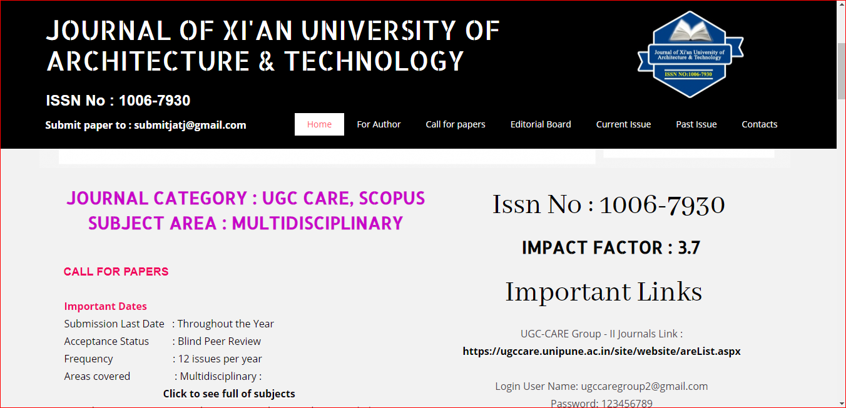
Cloned Journal

Slide 13
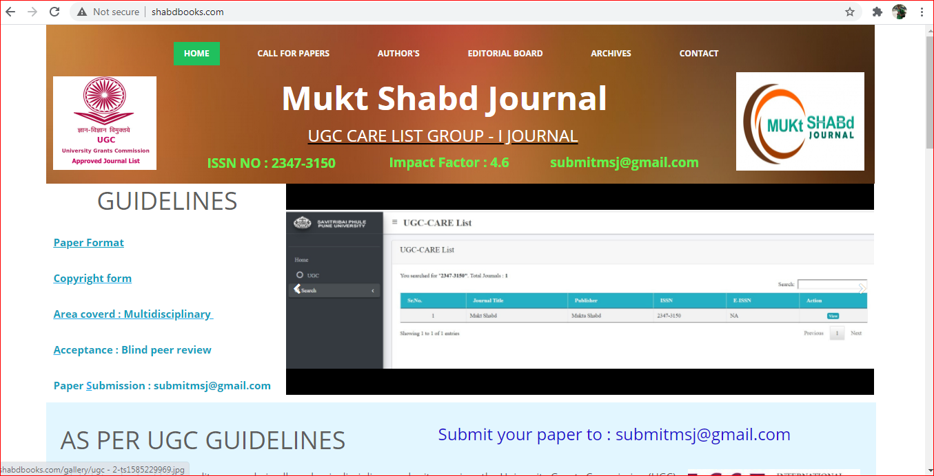
One more Cloned Journal

Slide 14
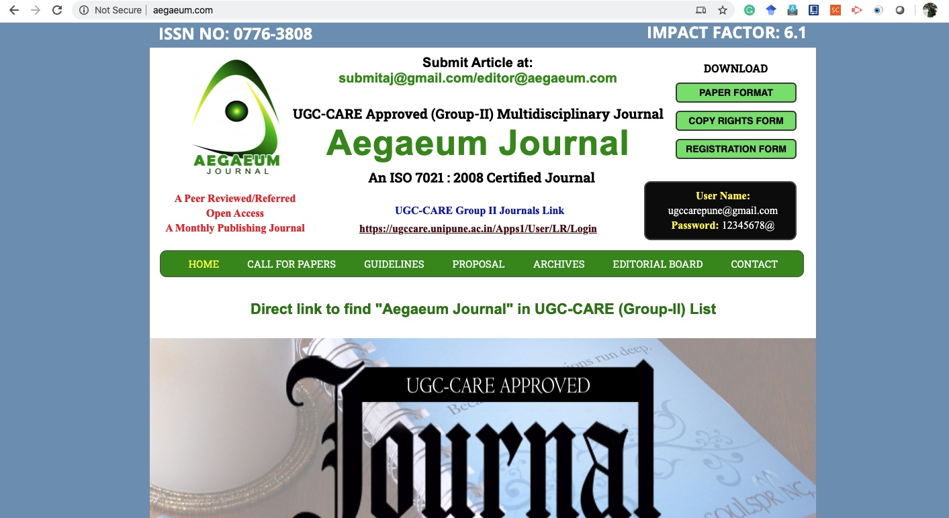
Cloned journals also use the stamps of SCOPUS, WOS & UGC CARE

Slide 15
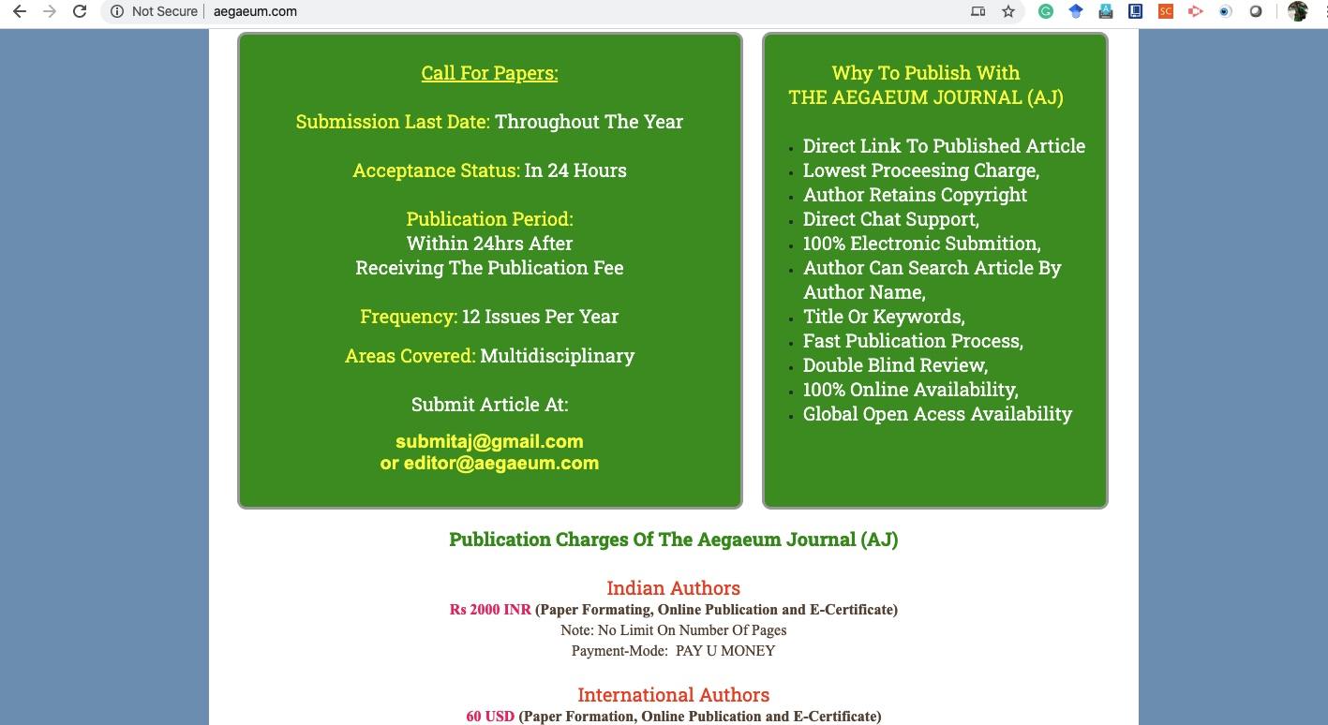
They will always charge money and will give you early publications and will use Gmail id for conversation

Slide 16
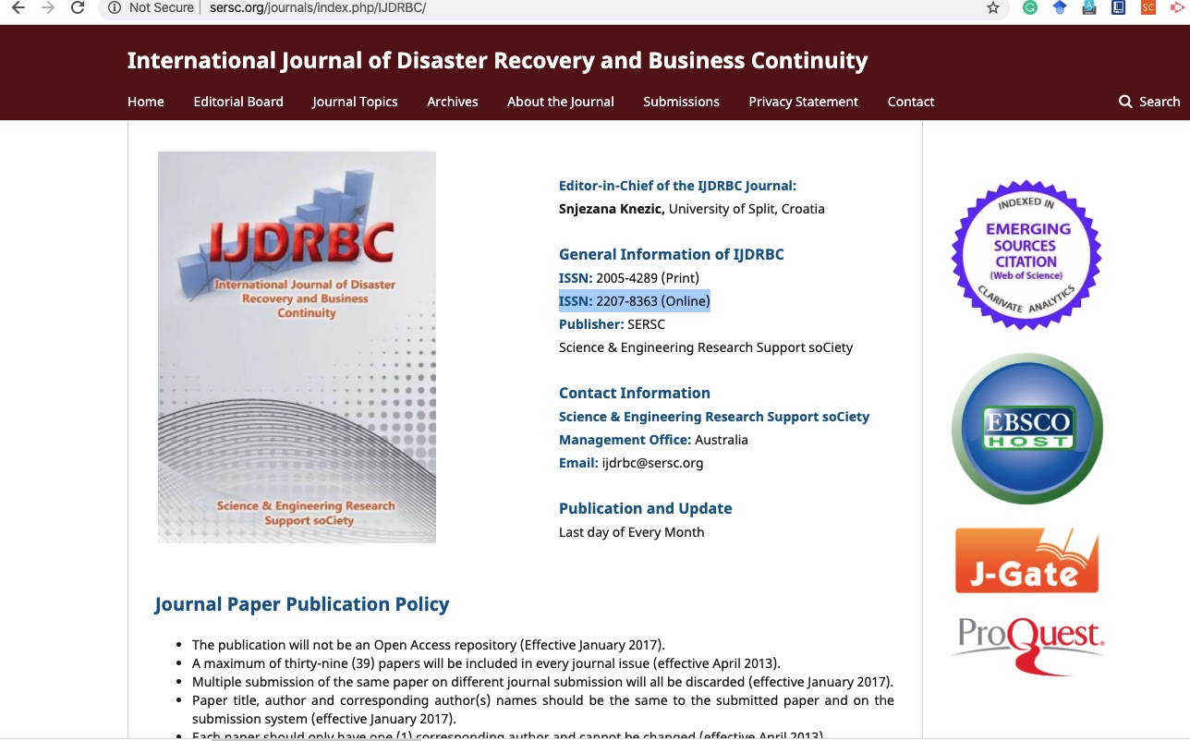
One more cloned journal

Slide 17
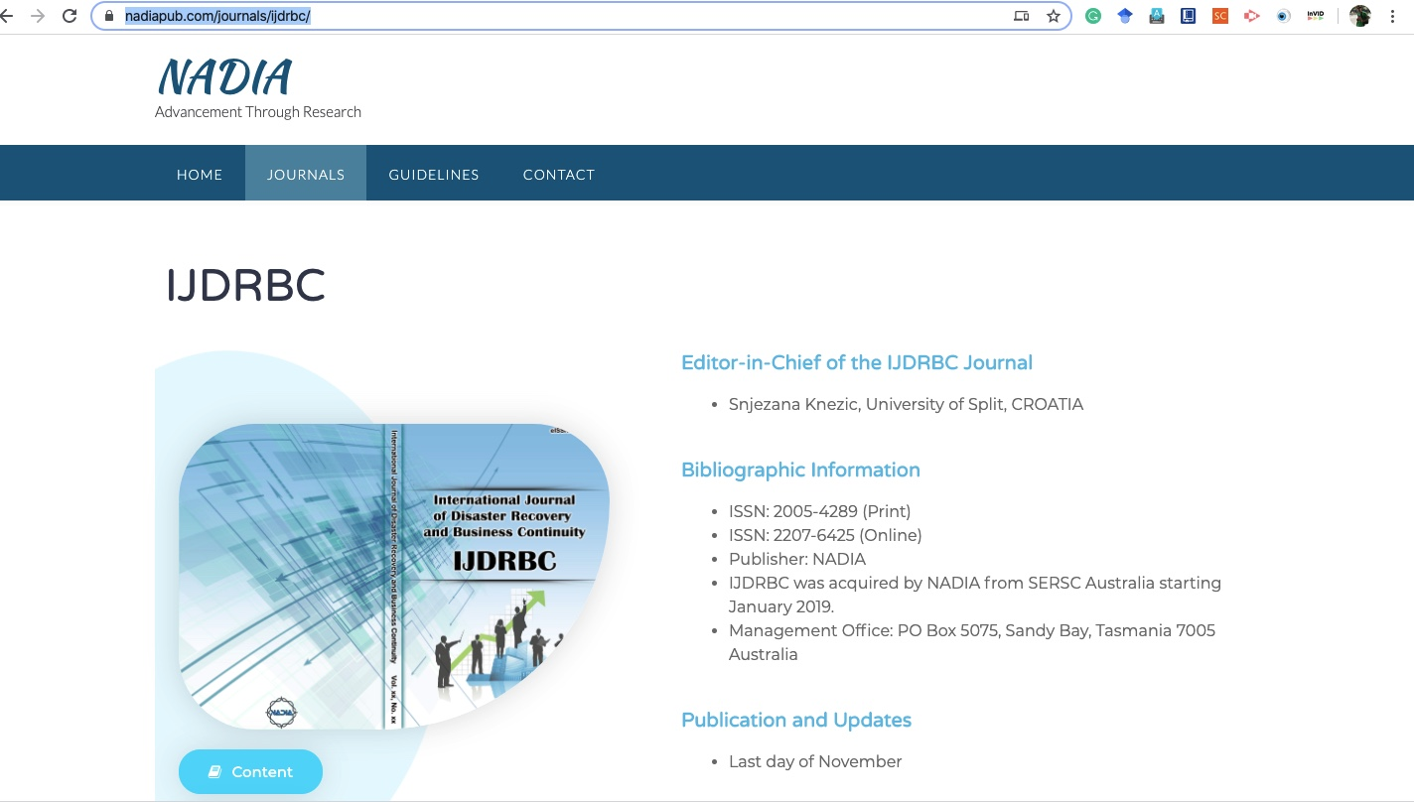
Original Website

Slide 18
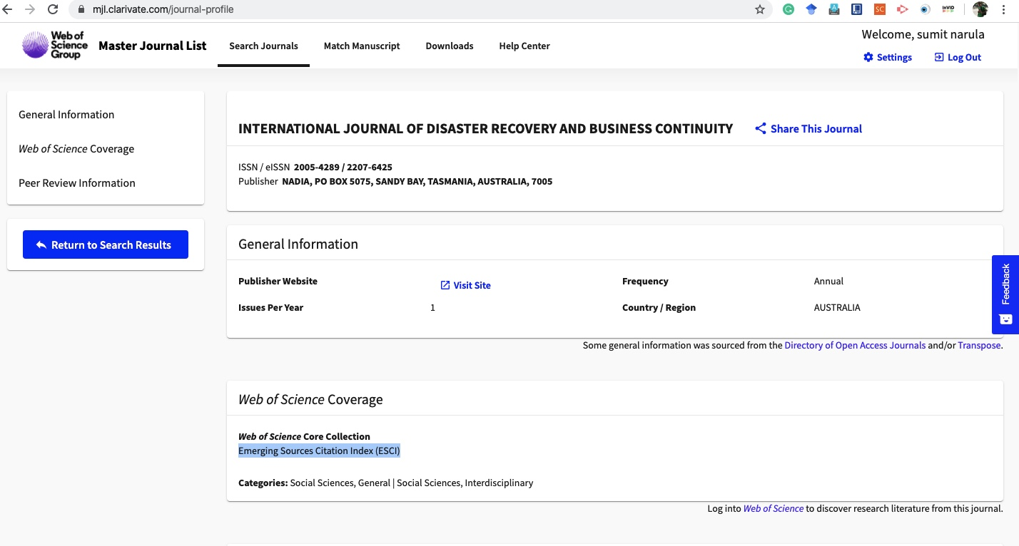
Verification at Web of Science database

Slide 19
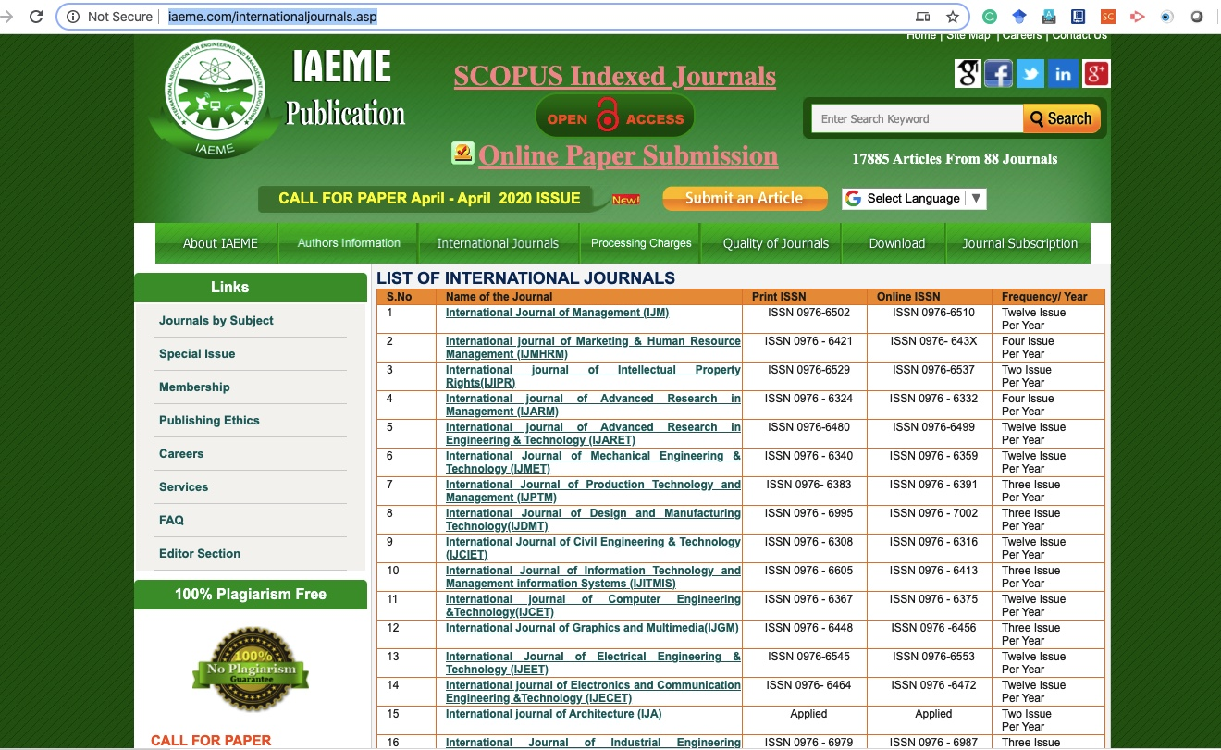
Most of them will be having multiple journals doing the same job

Slide 20
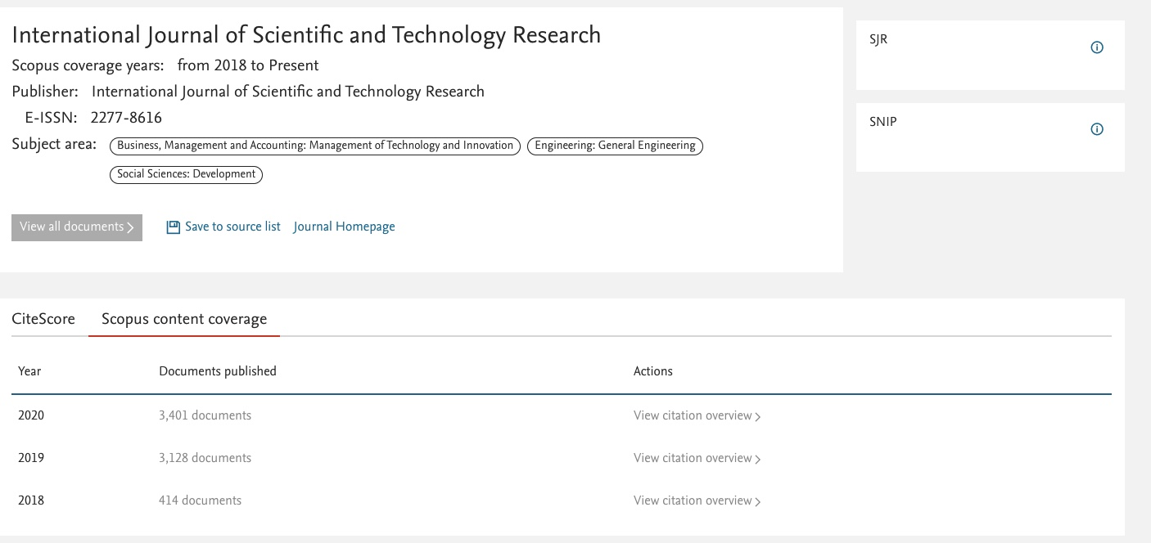
Predatory Journal

Slide 21
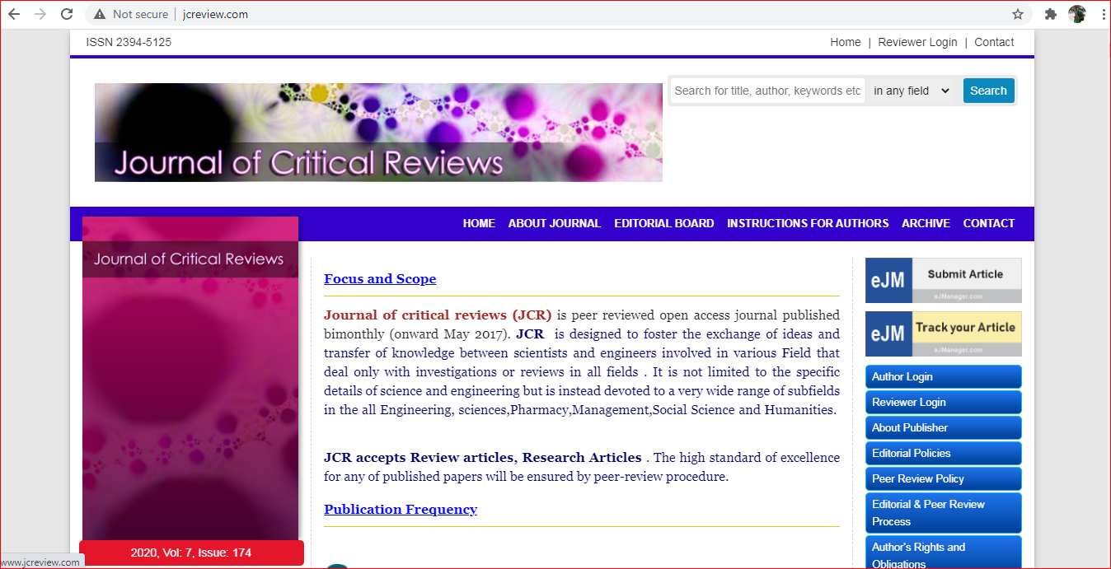
Predatory Journal

Slide 22
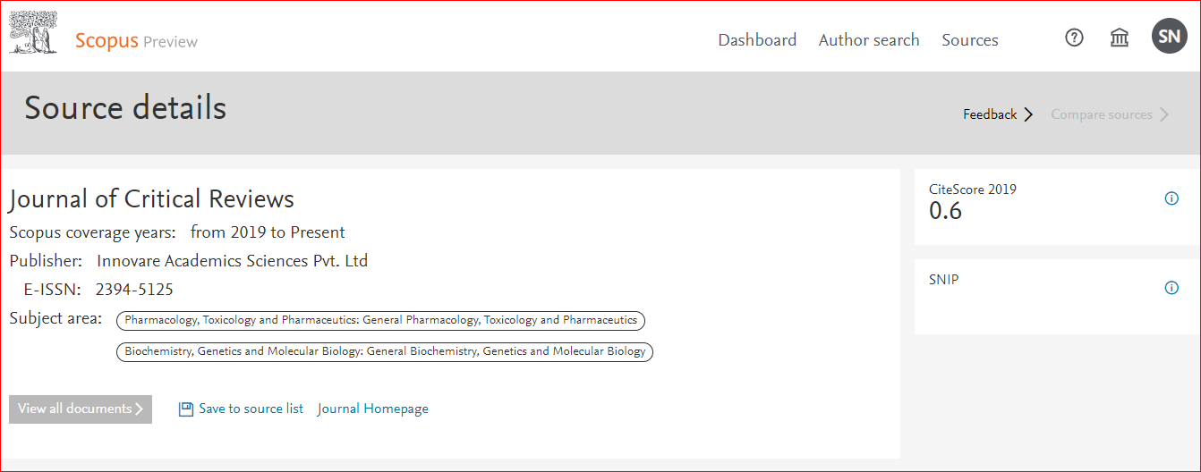
Look at the subject area, this journal cannot publish in other areas

Slide 23
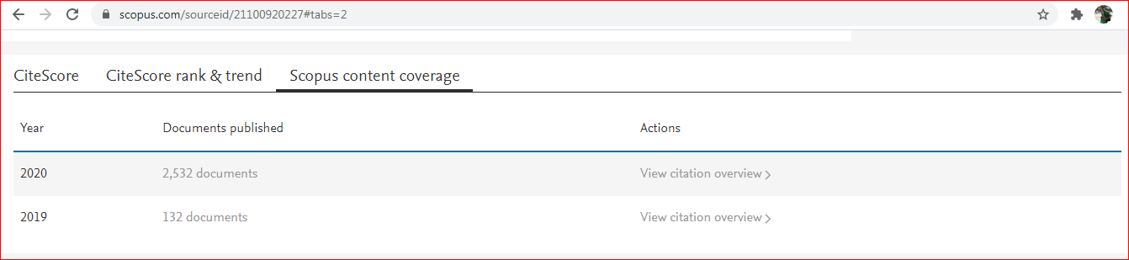
Check SCOPUS Content coverage, which is well beyond a permissible limit

Slide 24
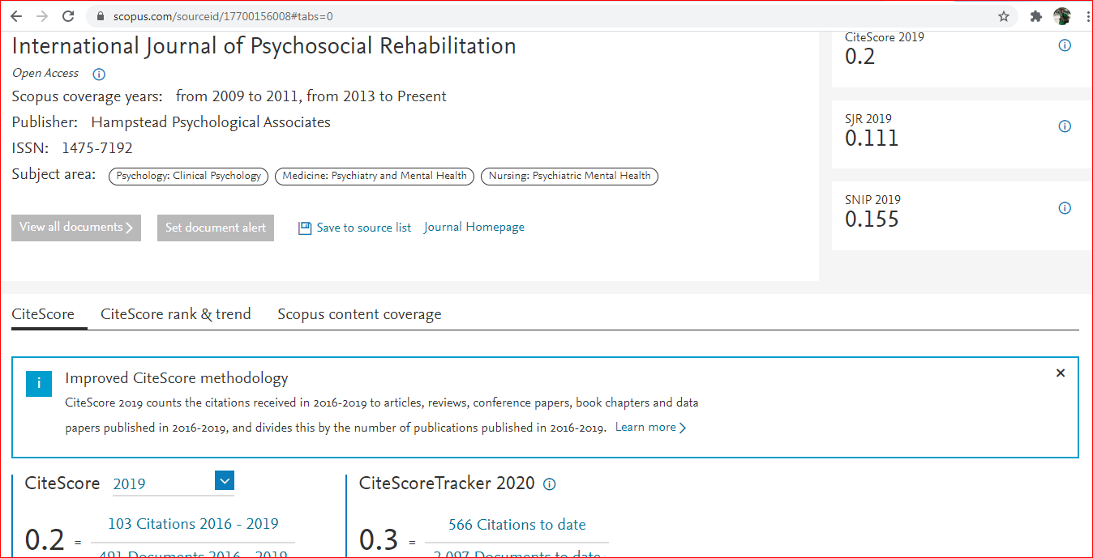
This journal has recently been removed

Slide 25
WOS
Journals
Science Citation Index Expanded (SCIE): clinical, natural and applied sciences
Social Sciences Citation Index (SSCI): social sciences
Arts & Humanities Citation Index (AHCI): arts and humanities
Emerging Sources Citation Index (ESCI): all disciplines
Books
Book Citation Index (BKCI): all disciplines
Conference proceedings
Conference Proceedings Citation Index (CPCI): all disciplines

Slide 26
CROSSREF LINK
https://www.crossref.org/metadatamanager/
There must be a working Digital Object Identifier (DOI) Number allotted to the paper. Most of the Predatory journals will not allot a working DOI Number

Slide 27
Always see the UGC CARE List before submitting to any journal
https://ugccare.unipune.ac.in/Apps1/User/LR/Login?ReturnUrl=%2FApps1%2FUser%2FWebA%2FCAREList

Slide 28
Always check the SCOPUS DATA before submitting to any journal
https://www.scopus.com/home.uri

Slide 29
Always check the WEB OF SCIENCE indexing
https://mjl.clarivate.com/home

Slide 30
Most renowned journals are now integrating the ORCID ID with research publications
https://orcid.org/0000-0002-2576-9022
It is one of the most important identity in a researcher life

Slide 31
Always check the making of the websites
http://whois.domaintools.com/

Slide 32
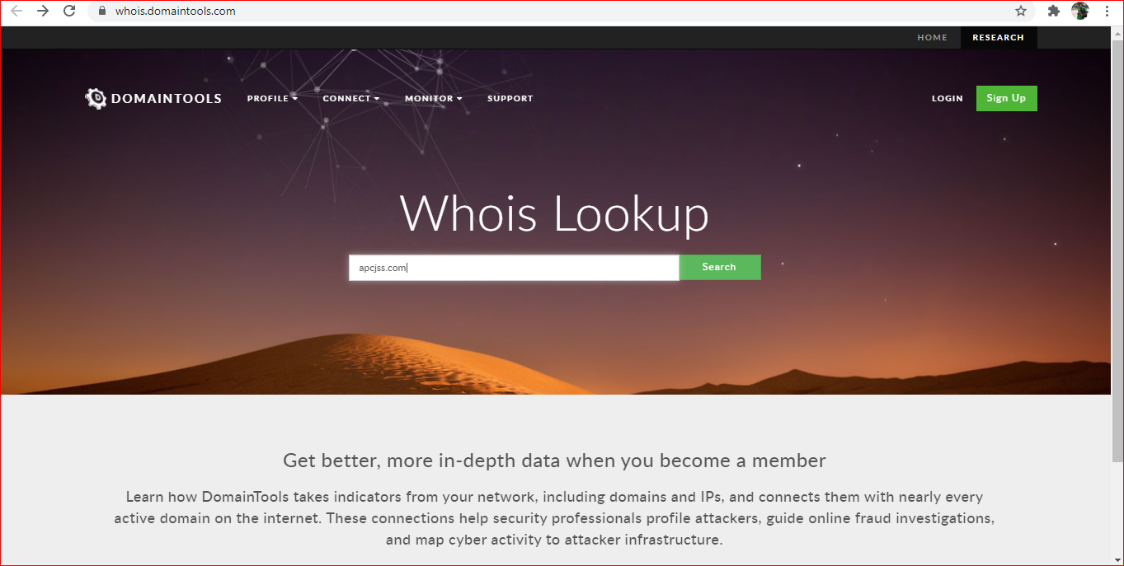
Making of website of Journal of Social Science

Slide 33
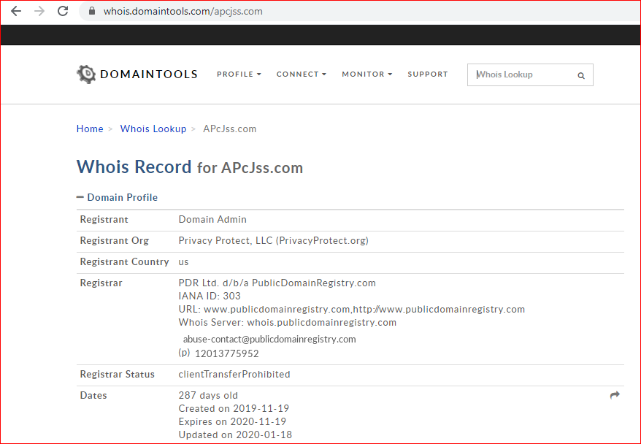
It is only 287 days old but the cloned website says it is 20 years old

